Slide 1

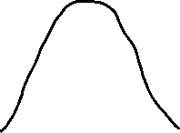




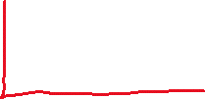


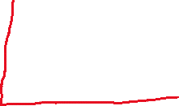




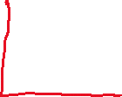



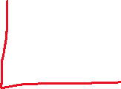

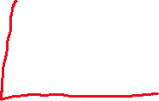

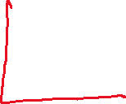


Analyzing breakage of each bin of the initial PSD
Broken fraction ($S_{i})$
Unbroken fraction (${1−S}_{i})$

Slide 2
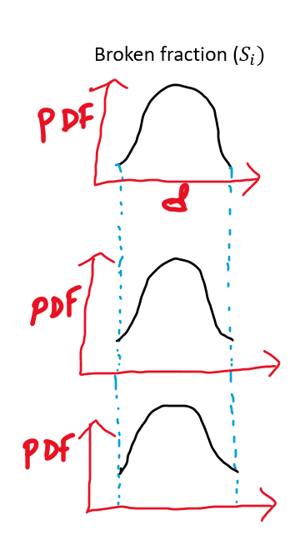
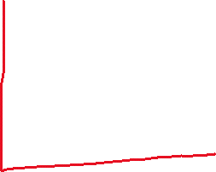

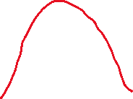

Analyzing breakage of each bin of the initial PSD (Contd)
We take an assumption here, that each bin of the initial PSD breaks in the same way, i.e., the ratio of daughter/mother diameter ratio follows a master curve.
Master PDF

Slide 3









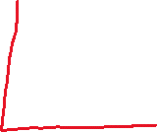
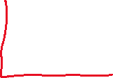

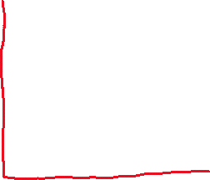

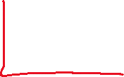




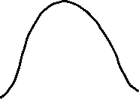



Analyzing breakage of each bin of the initial PSD (Contd)
Broken fraction ($S_{i})$

Slide 4
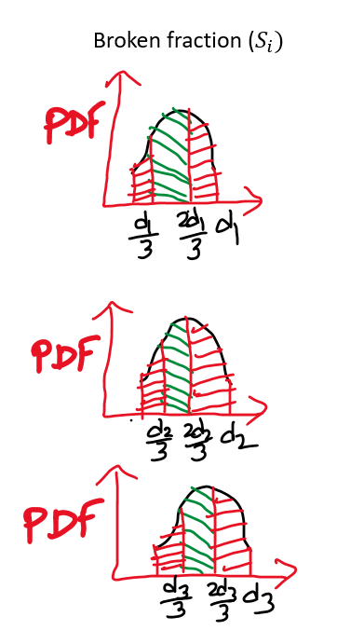




Analyzing breakage of each bin of the initial PSD (Contd)

Slide 5



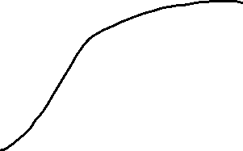

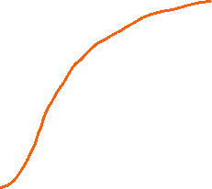
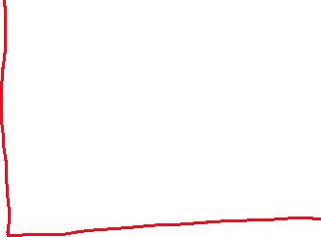

Constructing the real CDF (rebound)
This turns out to be an optimization problem which has optimization parameters
[$S_{i},p_{1},p_{2},p_{3}$]

Slide 6
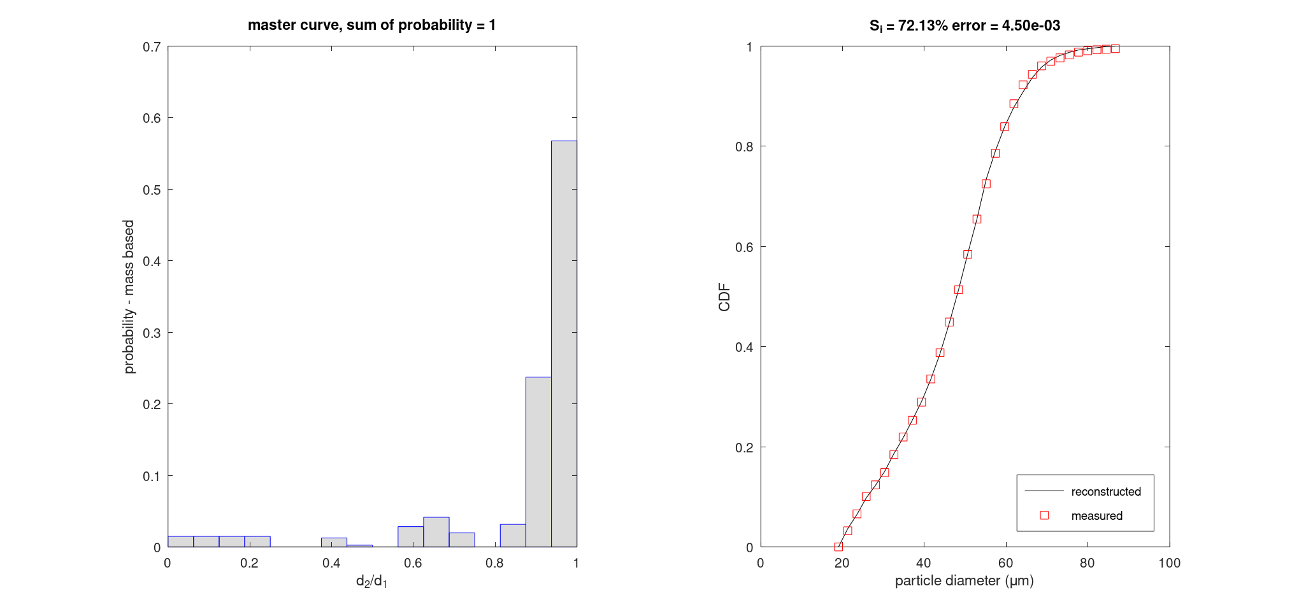
Breakage of Stainless Steel
Speed OP1, angle 50 degrees

Slide 7
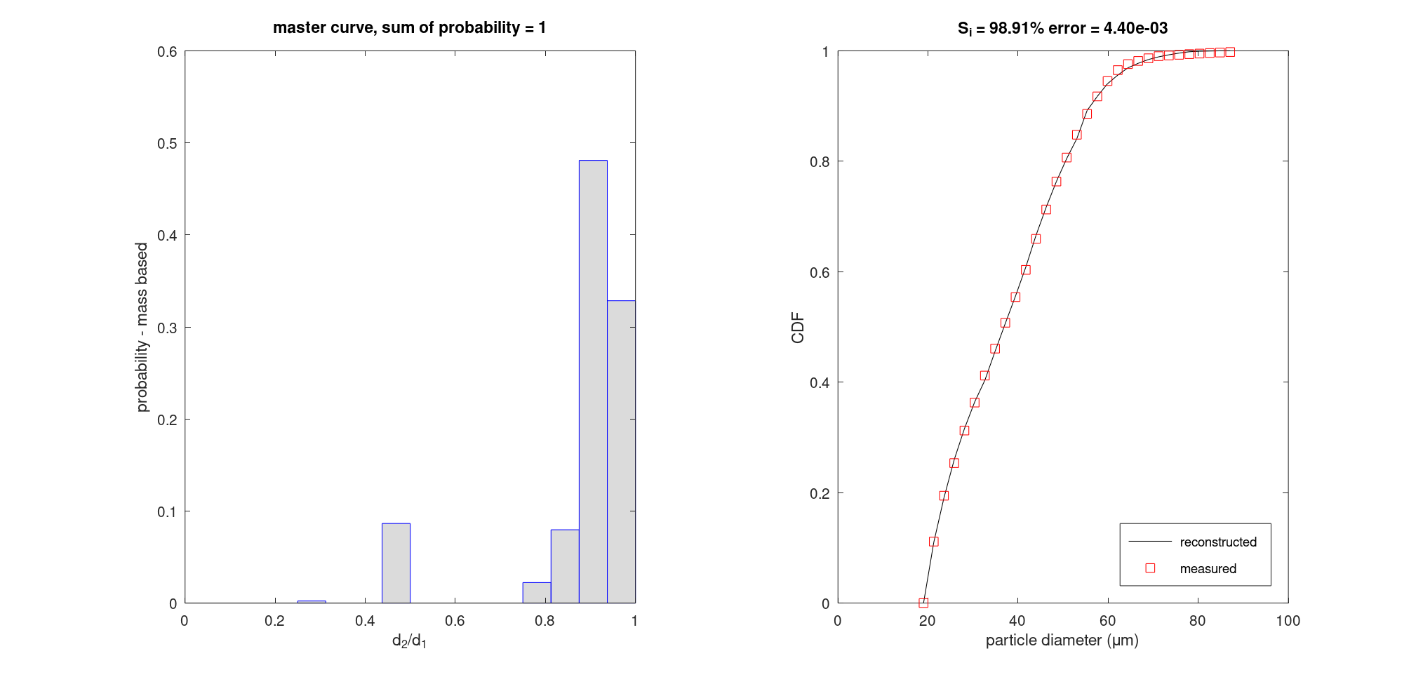
Breakage of Ti6Al4V
Speed OP3, angle 90 degrees

